Slide 1

Data Streaming & Analytics in Smart Cities Presented by: Shreyas Ramakrishna, Veena Nalluri, Sanchita Basak & Anabil Munshi Spring 2018 CS 6381: Distributed Systems Principles Project presentation April 17th 2018

Slide 2
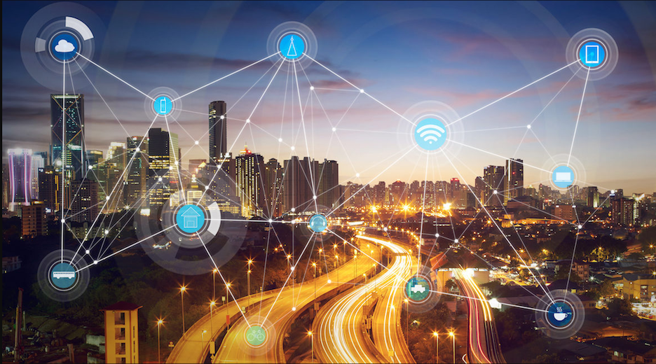
Contents
Smart City: Overview & Goals
Ongoing Smart City Projects
Data Flow Architecture
Cloud- Fog
Data Analytics
InfluxDB and Grafana
Our Architectural idea
Example Implementation
Some initial results
Challenges
Conclusion & Future work

Slide 3
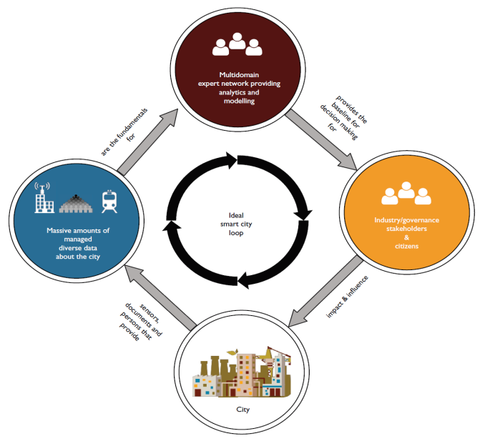
Smart City: local but networked, distributed but integrated
“An urban area that uses different types of electronic data collection sensors to supply information which is used to manage assets and resources efficiently.” *
*Hamblen, Matt. “Just what IS a smart city?”; Image source: Schleider et al. (2015) [Ref 9]

Slide 4
Smart City Goals
Using ICT to create a sustainable energy-efficient urban ecosystem
Intelligent sensor-based infrastructure to collect and report real-time data for monitoring performance and trends of city services
Integration of data from various sources: tying together services, mobility, infrastructure and energy
Urban analytics platform to address complex challenges (e.g. network efficiency, environmental sustainability, prediction of future conditions, etc)

Slide 5
Background: Some ongoing smart city projects
Sterling Ranch: 12,000-home smart city in Colorado. Connected by fiber-optic network. Residents can monitor water and energy usage.
Array of things: Real-time networked urban sensor project in Chicago. “Fitness tracker” for the city. Measures livability factors like climate, air quality and noise.
Fujisawa SST: Sustainable smart town near Tokyo. Total mobility service linking electric vehicles and EV bikes. Town energy networks and town information networks to provide real-time energy-saving recommendations that are tailored to residents’ way of life.

Slide 6
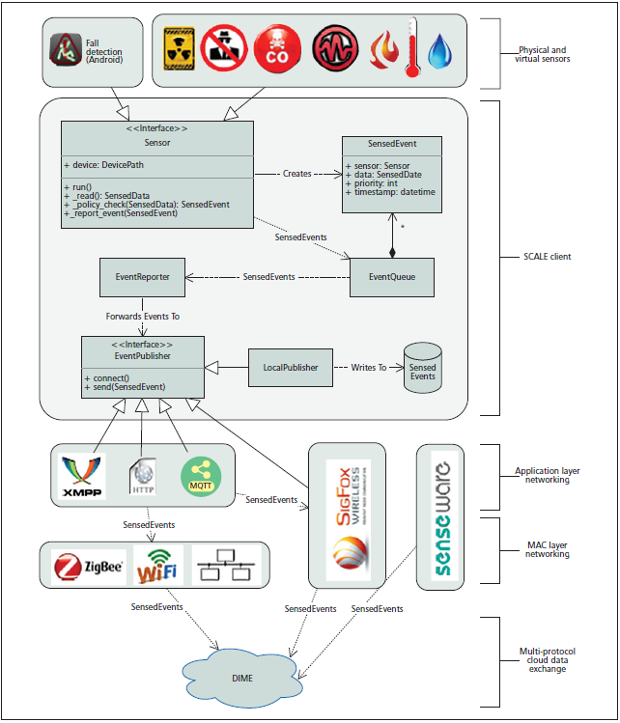
DataFlow architecture
SCALE ( Safe Community Awareness and Alerting Network ) devices upload sensed events, and the analytics service looks for possible anomalies, it sends residents alerts to confirm or reject, and allows to visualize events through a dashboard.
*Image source Ref: [7]

Slide 7
DataFlow architecture
On detection of anomalous events, users should receive alert messages.
The architecture should allow independent development and deployment of applications.
It should allow the feature of plug and play to accommodate heterogeneous sensor devices into the infrastructure.
The architecture should be secure, reliable, robust and should have lesser downtime with increased availability.

Slide 8
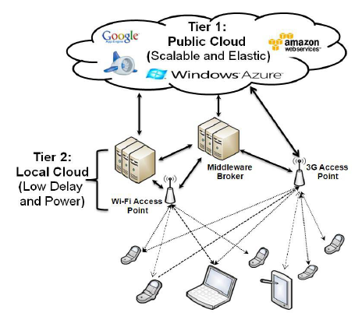
Cloud computing
Cloud computing: Delivery of computing services over the internet.
Some well known cloud vendors are Amazon, Google and Microsoft.
Pros: Flexible capacity, availability, accessible, reliability, availability, etc.
Cons: Privacy, security, cost and latency for safety critical systems.
2-Tier cloud: Based on the application requirement, multi-tier cloud could be used for improving latency, power, costs.
Idea to run the computation close to source of
origination.
*Image source: Ref: [6]

Slide 9
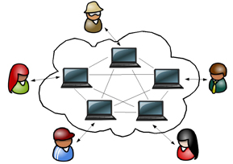
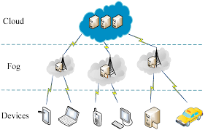
Cloud-Fog computational paradigm
Community Cloud : Digital ecosystem to spin up a virtual data center.
Works on the available computational resource of the users.
Works on community trust.
Pros: less expensive, complete control of the data center.
Cons: Security, substandard processing & storage capacity.
Fog computing: Decentralized computing infrastructure.
Somewhere between the source and the cloud.
Pros: Supports mobility, reduced latency, reduced bandwidth.
Cons: Placement of fog servers, energy consumption.
*Image source: google

Slide 10
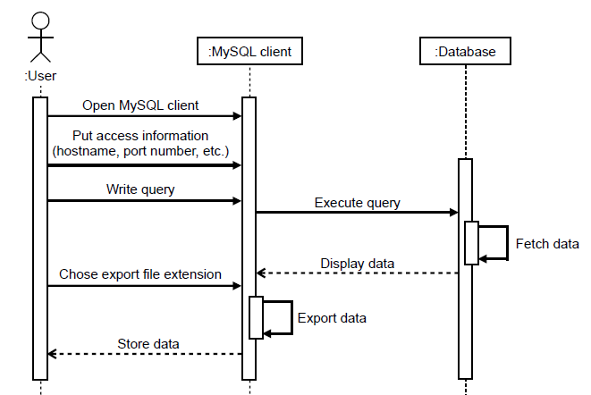
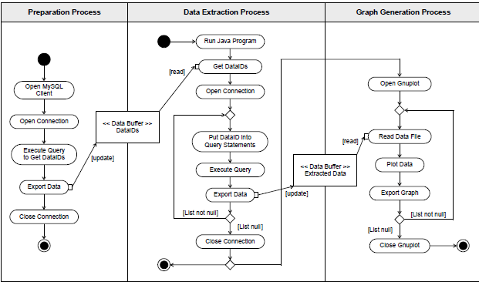
Data Management
Backend data management for queries and analytics has become vital with the increase in IoT data.
Pecan street smart grid data management scheme gave one of the first architectures for data query and analytics.
The architecture had a SQL DB with high granular sensor data, which could be queried by the users using MySQL workbench.
*Image source: Ref: [1]

Slide 11
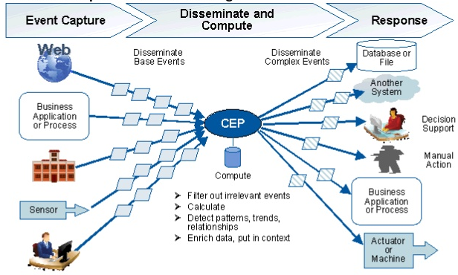
Data analytics
Batch Processing: Involves operating over a large, static dataset and returning the result at a later time when the computation is complete.
Stream Processing: Systems compute over data as it enters the system.
Complex Event Processing: System computes over multiple streams of data as it enters the system. Is widely used for real time analytics of sensor data.
*Image source: google

Slide 12
InfluxDB and Grafana
InfluxDB: Data store for large amount of time stamped IOT sensor data.
Continuous queries and flexible Retention policies.
InfluxQL similar to SQL query language.
Through simple query, filtering and window you could do anomaly detection.
Open Source, handles high data ingest and real time querying of sensor data.
Data compression on storage.
Grafana: Open tool platform for analytic and monitoring data.
Built in InfluxDB support.
A dashboard with rich query support for plotting graphs.
Simple query for users to get a graphical look at the sensor data.
*Image source: google

Slide 13

Building from literature survey

Slide 14
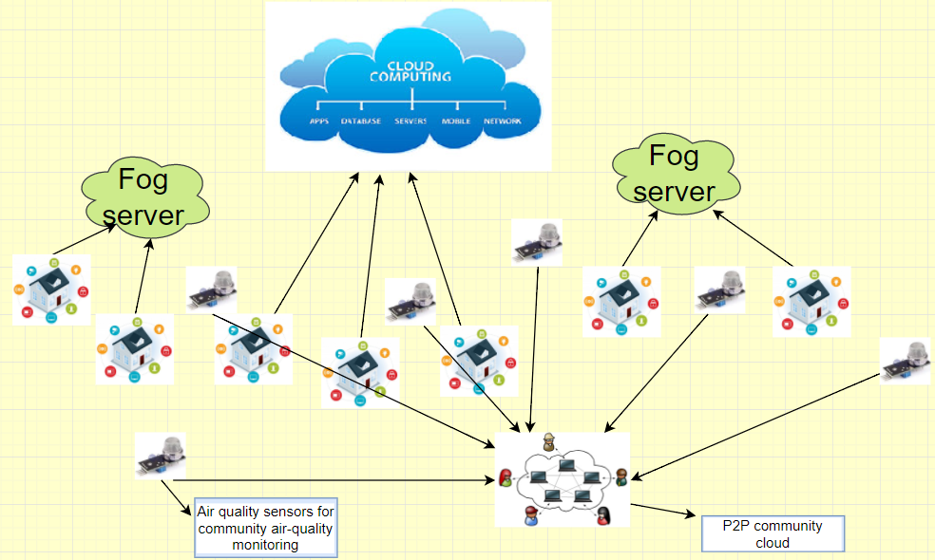
Architectural Overview

Slide 15
Implementation
Frontend sensor integration using python openzwave library.
A small scale implementation of the architectured publishing information from homes to database on the cloud.
Implemented encrypted ZMQ middleware for data transportation between homes and influxDB instance on server.
Running influxDB instance on an instance in the cloud. (security: DNSSEC, ufw(firewall), private key login)
Plotting graphs for the sensor data received, using Grafana.

Slide 16
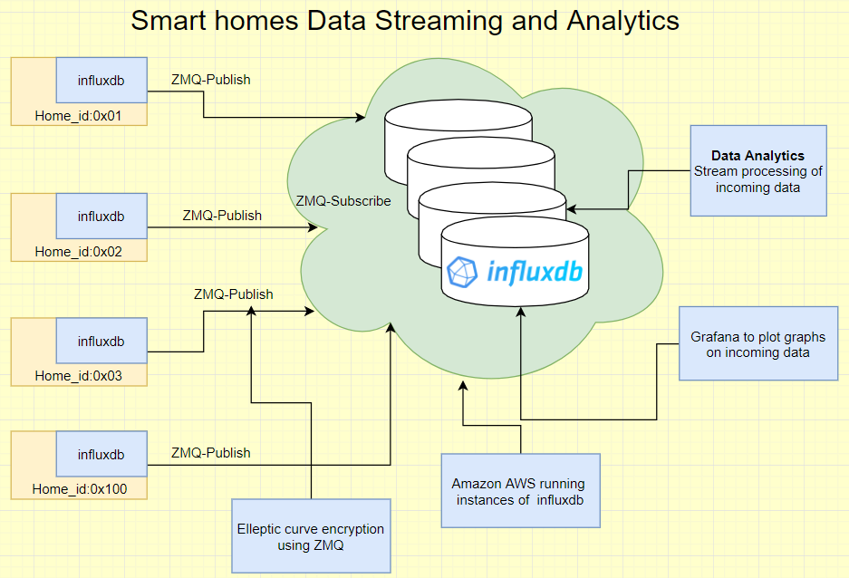
Data Stream from homes

Slide 17
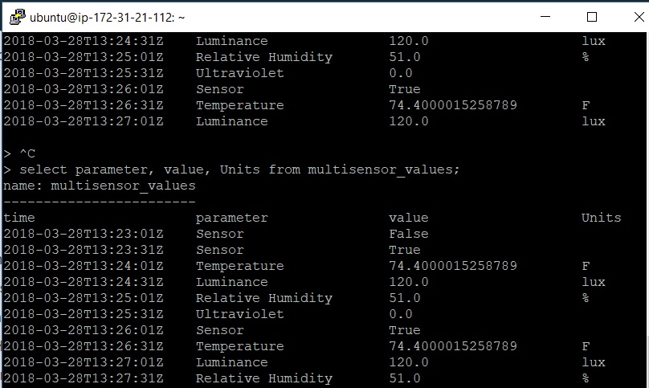
Sensor data

Slide 18
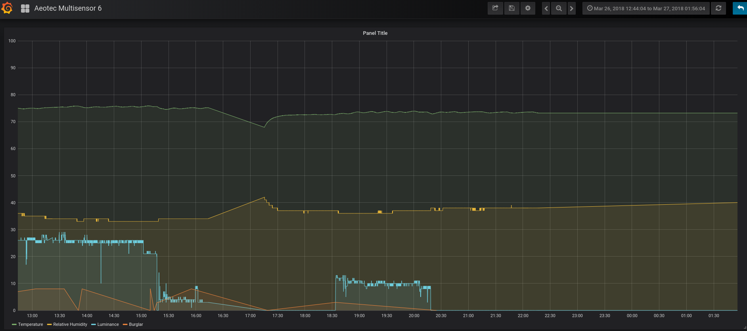
Data collected statistics

Slide 19
Architectural challenges
Security: Data security throughout streaming and analytics is challenging.
Data should be encrypted/ anonymized to prevent attacks.
Reliability: Any part of the system can break down and our architecture should tolerate it.
Plug & play: A number of heterogeneous sensors should be able to work over our platform.
Location Transparency: Our data storage and analytic server should be available anywhere.
Data Offloading: Some robust offloading techniques between different computation paradigms to reduce latency, cost and delays.

Slide 20
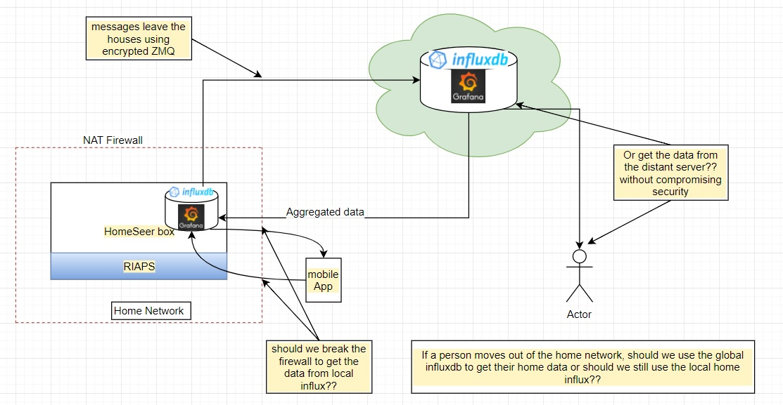
Architectural challenges

Slide 21
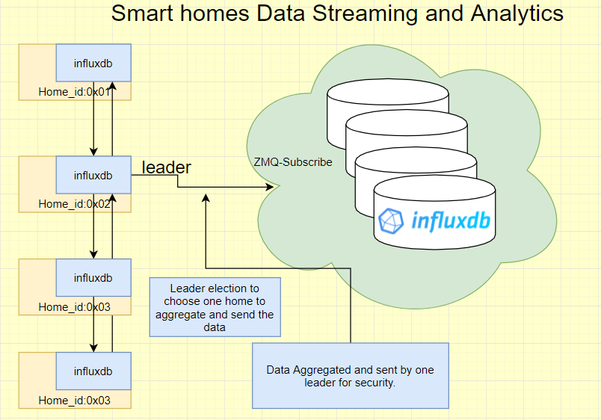
Architectural challenges

Slide 22
Conclusion & Future Work
We have tried to build a smart city data streaming and analytic architecture.
Our idea builds on the literature survey in the areas of computation, data streaming and analytics.
Assimilating ideas from the literature, we have come up with the architecture discussed above.
A simple implementation of smart home data streaming is built using our architecture.
Future work:
We will have to investigate further about the feasibility of different computational paradigms and their performances.
We also need to think about the architectural challenges discussed above.
Introduce some online query techniques using complex event processing.

Slide 23
References
[1] K. Nagasawa, C. R. Upshaw, J. D. Rhodes, C. L. Holcomb, D. A. Walling, and M. E.Webber, “Data management for a large-scale smart grid demonstration project in Austin, Texas,” in Proc. Energy Sustainability, ASME 2012 6th Int. Conf., 2012, pp. 1027–1031.
[2] S. Jayasekara, S. Kannangara, T. Dahanayakage, I. Ranawaka, S. Perera, and V. Nanayakkara. Wihidum: Distributed complex event processing. J. Parallel Distrib. Comput., 79:42–51, 2015.
[3] M. Satyanarayanan, Mobile computing: the next decade, in: Proceedings of the 1st ACM Workshop on Mobile Cloud Computing & #38; Services: Social Networks and Beyond, MCS’10, ACM, New York, NY, USA, 2010, pp. 5:1–5:6.
[4] S. Shekhar, A. Chhokra, A. Bhattacharjee, G. Aupy, and A. Gokhale, “INDICES: Exploiting edge resources for performance-aware cloudhosted services,” 2017.

Slide 24
References
[5] Briscoe, G. and Marinos, A. (2009), “Digital ecosystems in the clouds: towards community cloud computing”. In: IEEE 2009 the 3rd IEEE International Conference on Digital Ecosystems and Technologies (DEST 2009), New York, USA, pp. 103-108.
[6] M. R. Rahimi, N. Venkatasubramanian, S. Mehrotra, and A. V. Vasilakos, “MAPCloud: Mobile applications on an elastic and scalable 2-tier cloud architecture,” in Proc. IEEE/ACM 5th International Conference on Utility and Cloud Computing (UCC’12), Chicago, Illinois, USA, Nov. 2012, pp. 83–90.
[7] M. Y. S. Uddin, A. Nelson, K. Benson, G. Wang, Q. Zhu, Q. Han, N. Alhassoun, P. Chakravarthi, J. Stamatakis, D. Hoffman, L. Darcy, N. Venkatasubramanian, "The SCALE2 multi-network architecture for iot-based resilient communities", Proc. of IEEE International Conference on Smart Computing (SMARTCOMP), pp. 1-8, May 2016.
[8] Pecan street research institute [Online]. 2013, Available: http://www.pecanstreet.org/
[9] J. M. Schleicher, M. Vogler, C. Inzinger, S. Dustdar, “Towards the Internet of Cities: A Research Roadmap for Next-Generation Smart Cities”, UCUI@CIKM, 2015.

